Slide 1
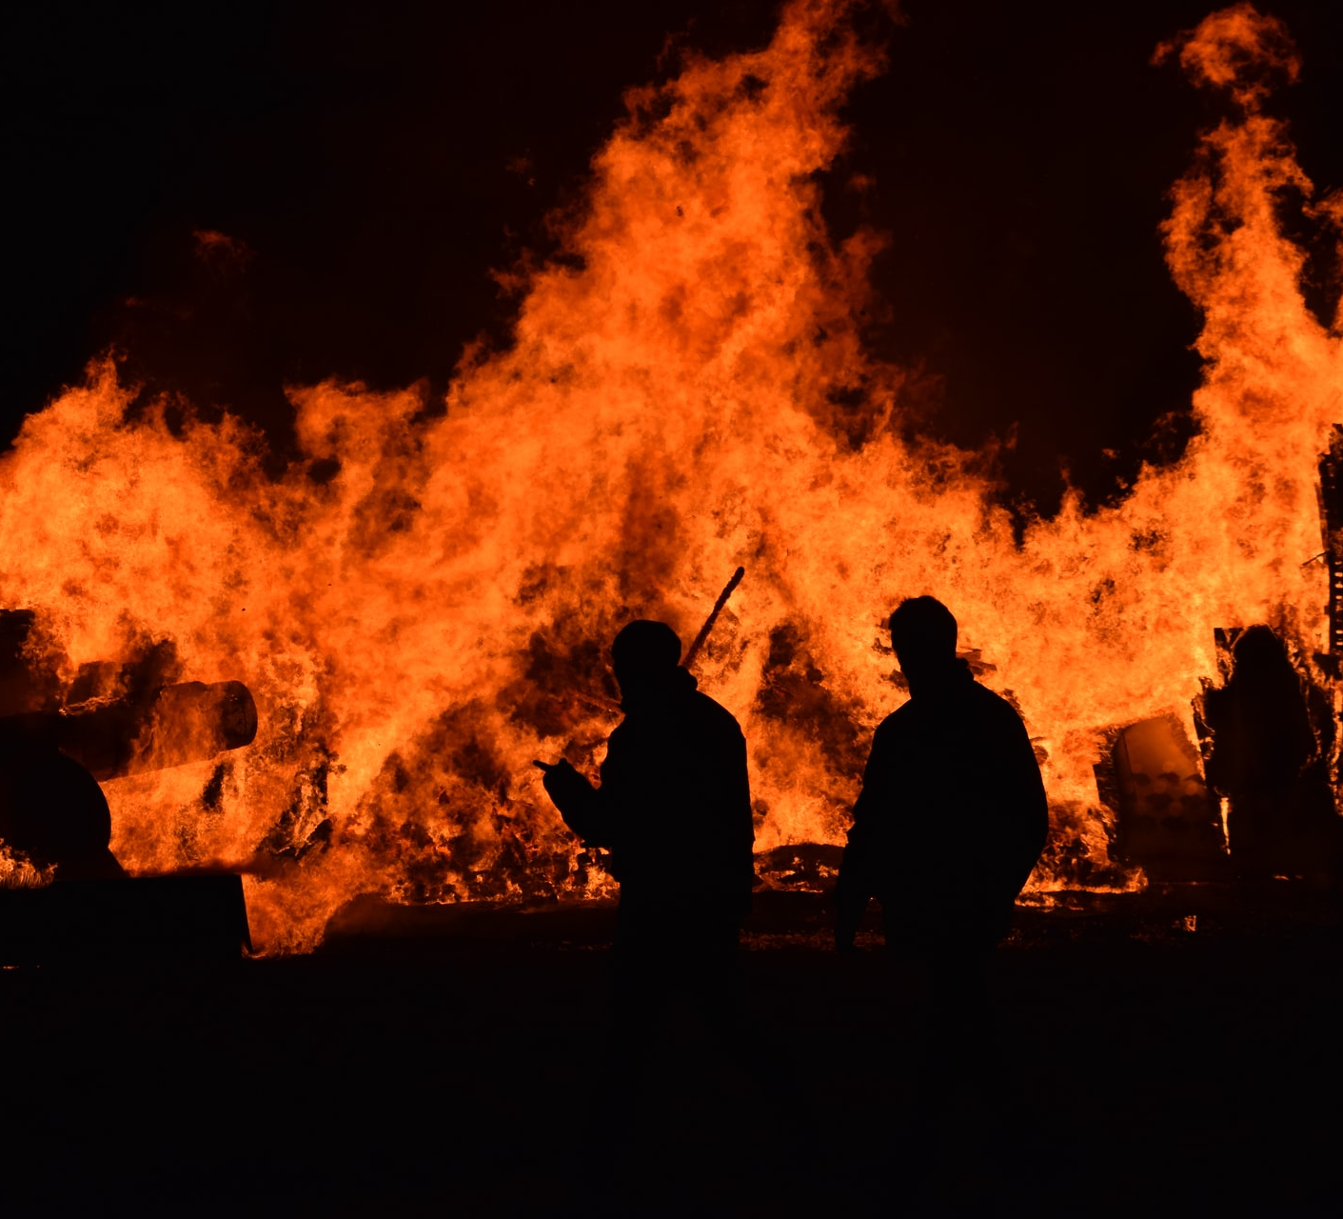
California Wildfire Dashboard Project
Team 7

Slide 2

Key Questions
Have California wildfires becomes more frequent?
Have California wildfires become larger?
Have California wildfires become more destructive?.

Slide 3
The Data
Wildfire Incident dataset
CSV dataset on Kaggle covering 2013-2019 that was originally scraped from https://www.fire.ca.gov/incidents/
https://www.kaggle.com/ananthu017/california-wildfire-incidents-20132020
Some Data Quality & Availability issues
A handful of incidents with missing or invalid coordinates – so while they are included in stats & queries, they do not appear on the map.
NIFC (National Interagency Fire Center) completely changed how wildfire incident data is managed & hosted in 2020, so we don’t have 2020 data.
Because of the cutoff point for this data, some of the 2019 incidents were not closed out and finalized when fully extinguished, so the 2019 data is a bit incomplete
Drought dataset
CSV dataset covering percentages of California in different levels of drought status from 2000-2021
https://droughtmonitor.unl.edu/Data/DataTables.aspx
Historical California Wildfire data is not easily accessible but we found a pretty good dataset covering 2013-2019.

Slide 4












Wildfire Incident data Solution architecture
NodeJS API serving up query endpoints
All ETL done on PostgreSQL
Conversion using csv2geojson library

Slide 5
Quick Demo
California Wildfire Dashboard

Slide 6
Findings
California wildfires have become more frequent over this time period.
California wildfires have not necessarily become larger during this period.
California wildfires have become more destructive?.

Slide 7
Findings
Have California wildfires become more destructive?.

Slide 8
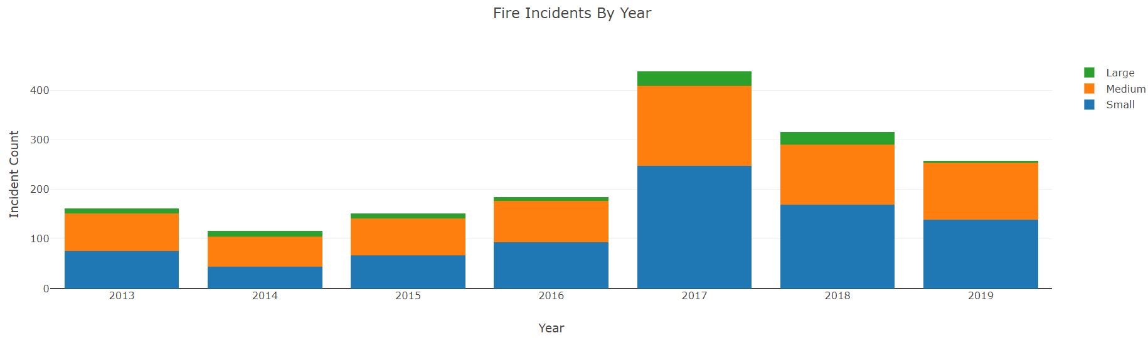
California wildfires have become more frequent over this time period.

Slide 9
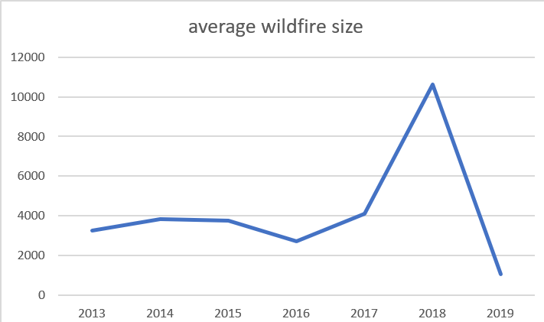
it is not clear that California wildfires have become larger, on average during this time period.

Slide 10
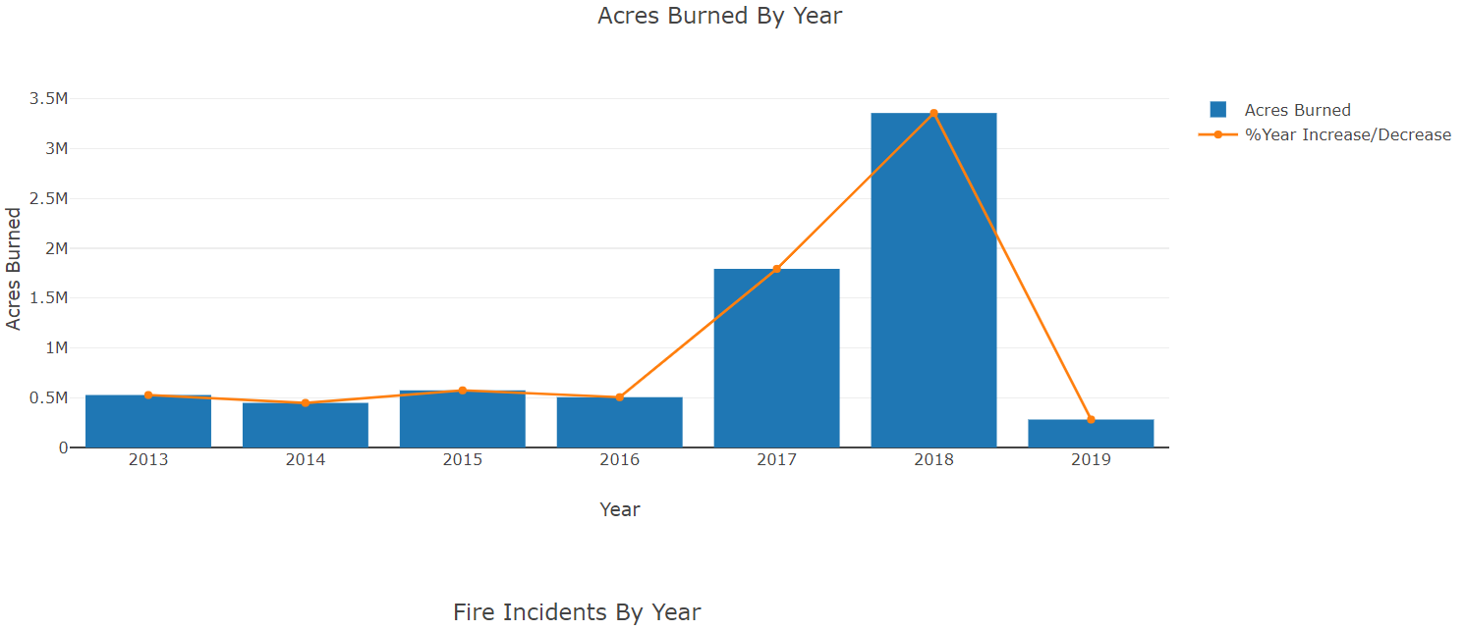
California wildfires have become more destructive over this time period.

Slide 11
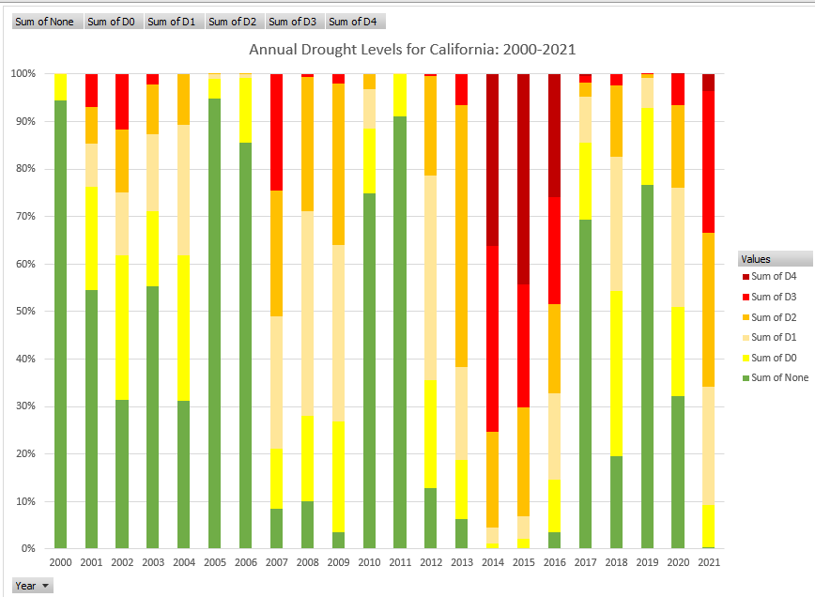
Contributing Factors
Could drought be a contributing factor?
Tree rings show that 2000-2018 is the driest 19-year period in centuries
Just looking at the last 20 years, there appears to be an increase in the percentage of California experiencing drought conditions
Drought

